Slide 1
CPU, GPU and TPU comparison for Deep learning
Name: Atharva Avinash Ingle
Roll No: 68
GR No: 11911080
Class: ICA
Batch: A3
Guide: Prof. Pramod Kanjalkar

Slide 2
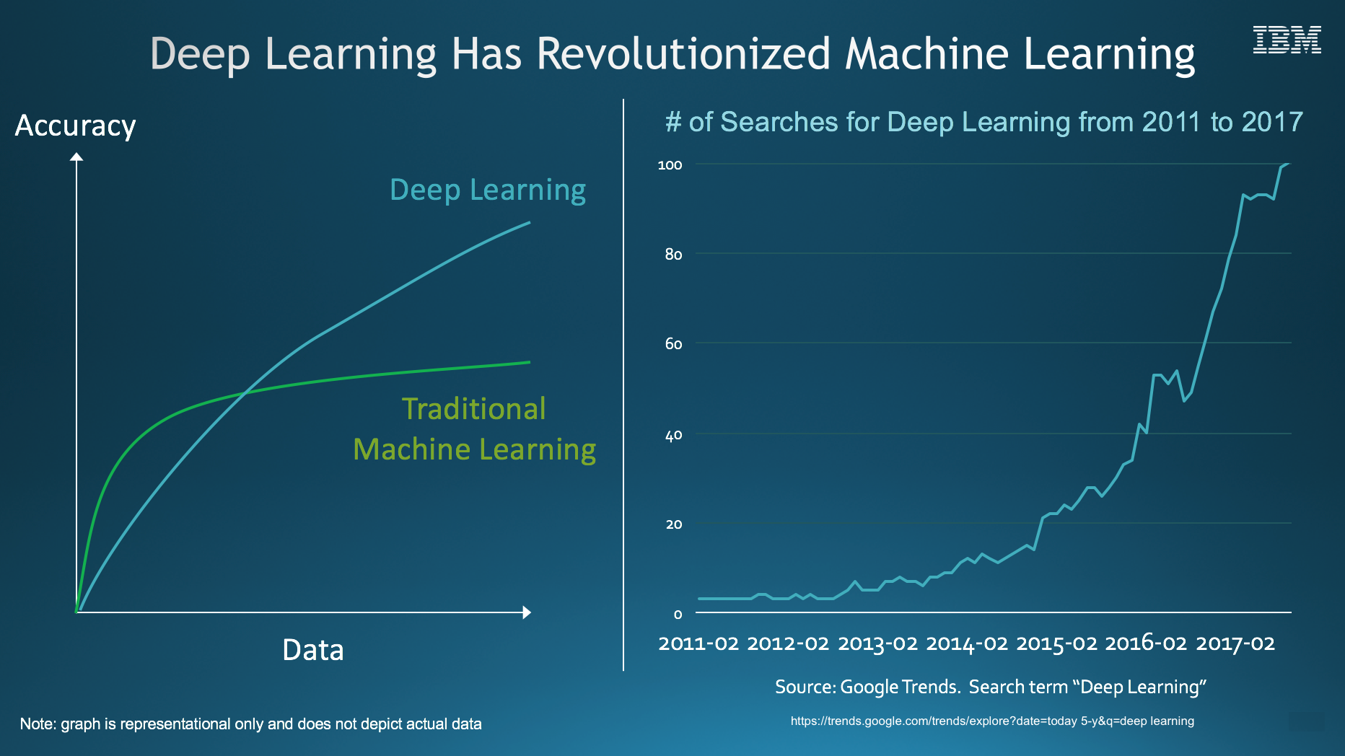
INTRODUCTION

Slide 3
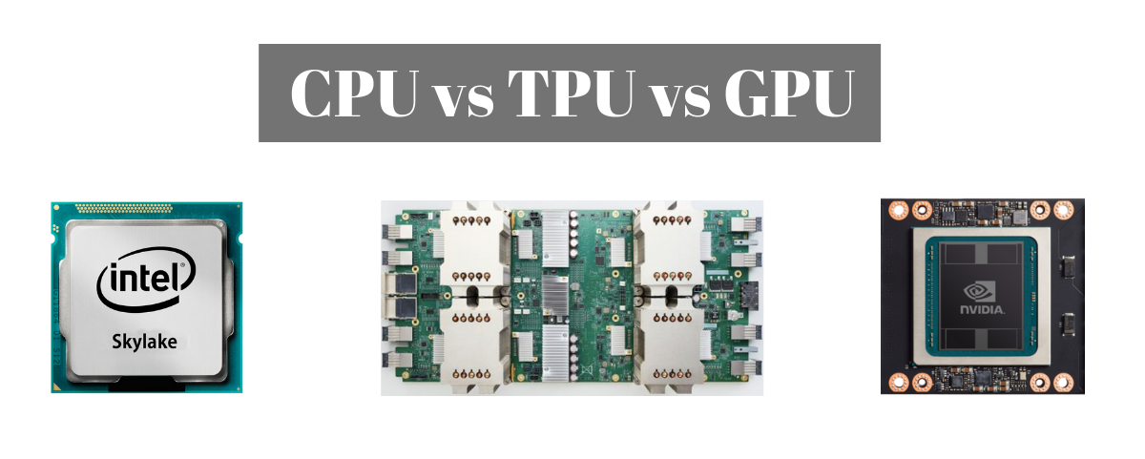
MOTIVATION
Source: https://miro.medium.com/max/1200/1*aghXQaSFQyo7lRPL6-73Bg.png

Slide 4
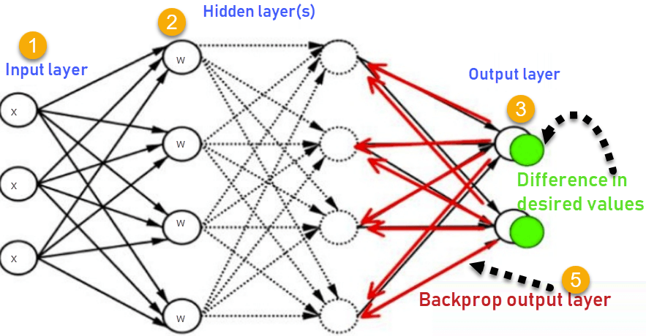
ARTIFICIAL NEURAL NETWORK

Slide 5

CONVOLUTIONAL NEURAL NETWORKS

Slide 6
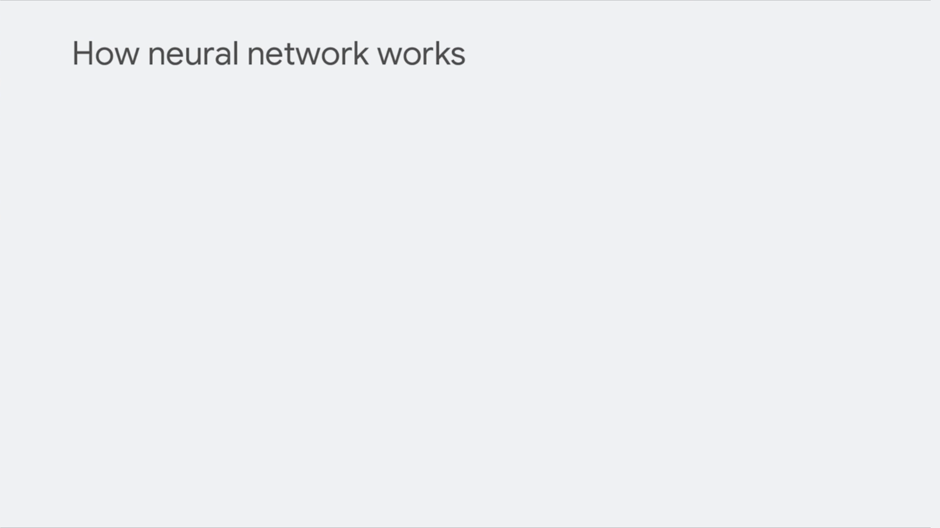

Slide 7
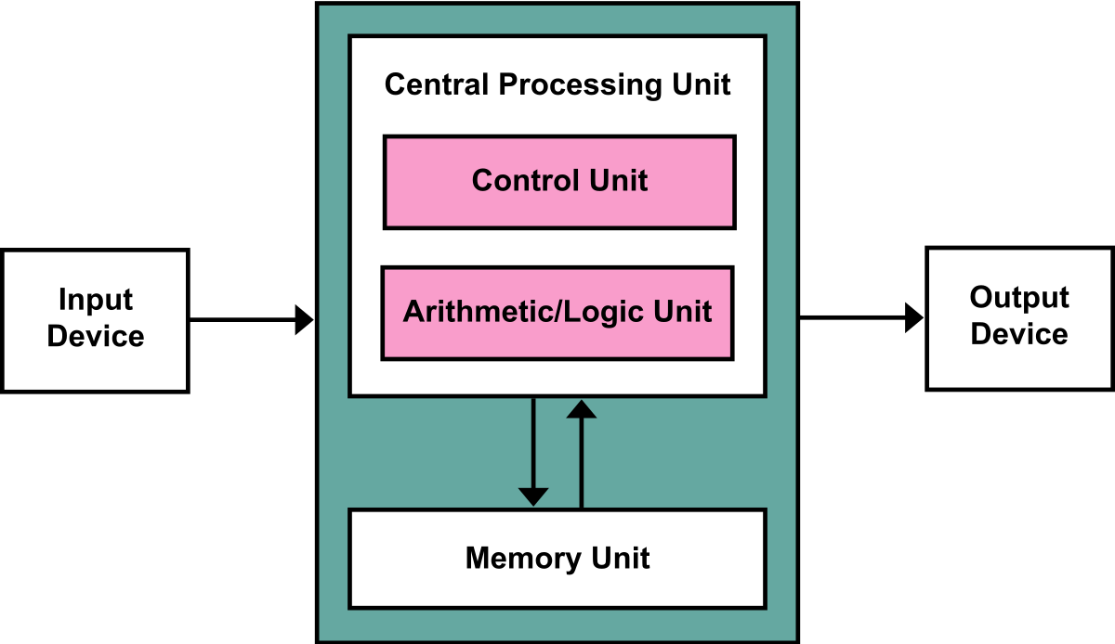
CPU
CPU is general purpose processor based on von Neumann architecture
Greatest benefit of CPU is flexibility
Can be used for different applications (editing documents, playing videos, etc)
As CPU is flexible, the hardware doesn’t know what would be next calculation until it reads the next instruction from the software
Source: https://upload.wikimedia.org/wikipedia/commons/thumb/e/e5/Von_Neumann_Architecture.svg/1200px-Von_Neumann_Architecture.svg.png

Slide 8
CPU
CPU has to store the calculation results on memory (registers or L1 cache) for every single calculation.
This memory access becomes the downside of CPU architecture
Source: https://upload.wikimedia.org/wikipedia/commons/thumb/e/e5/Von_Neumann_Architecture.svg/1200px-Von_Neumann_Architecture.svg.png

Slide 9
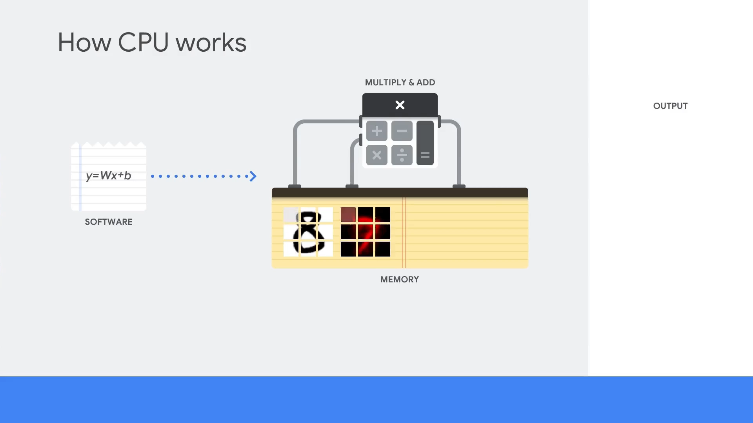

Slide 10
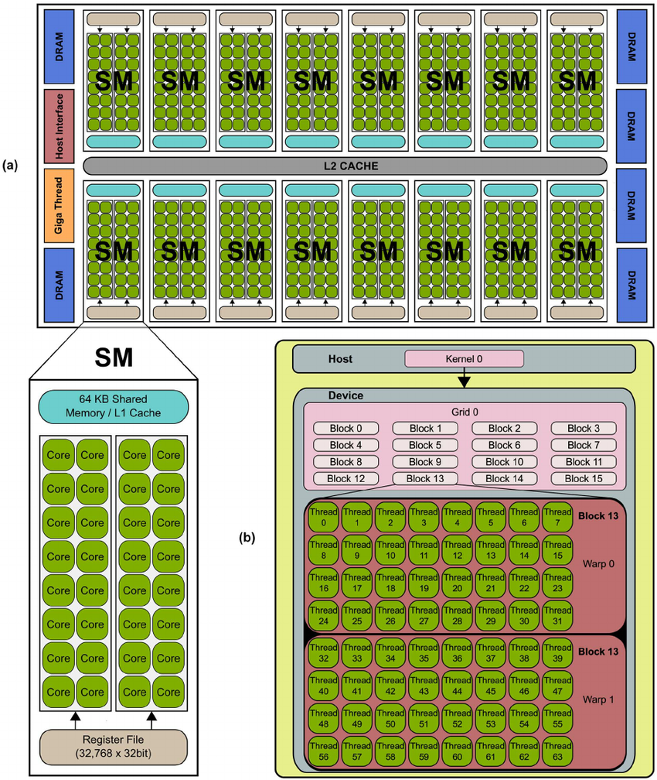
GPU
GPU have 1000s of ALUs in a single processor
Can execute 1000s of additions and multiplication simultaneously
Works very well on applications with massive parallelism, such as matrix multiplication in a neural network.
Most popular processor used in deep learning at present
Source: https://www.researchgate.net/profile/Stamatios-Sotiropoulos/publication/236666656/figure/fig1/AS:299544987357185@1448428498422/Typical-NVIDIA-GPU-architecture-The-GPU-is-comprised-of-a-set-of-Streaming.png

Slide 11
GPU
Still GPU is general purpose processor
GPUs still need to access registers or shared memory to read and store intermediate calculation
Von Neumann bottleneck problem
Also requires more energy and increases carbon footprint
Source: https://www.researchgate.net/profile/Stamatios-Sotiropoulos/publication/236666656/figure/fig1/AS:299544987357185@1448428498422/Typical-NVIDIA-GPU-architecture-The-GPU-is-comprised-of-a-set-of-Streaming.png

Slide 12
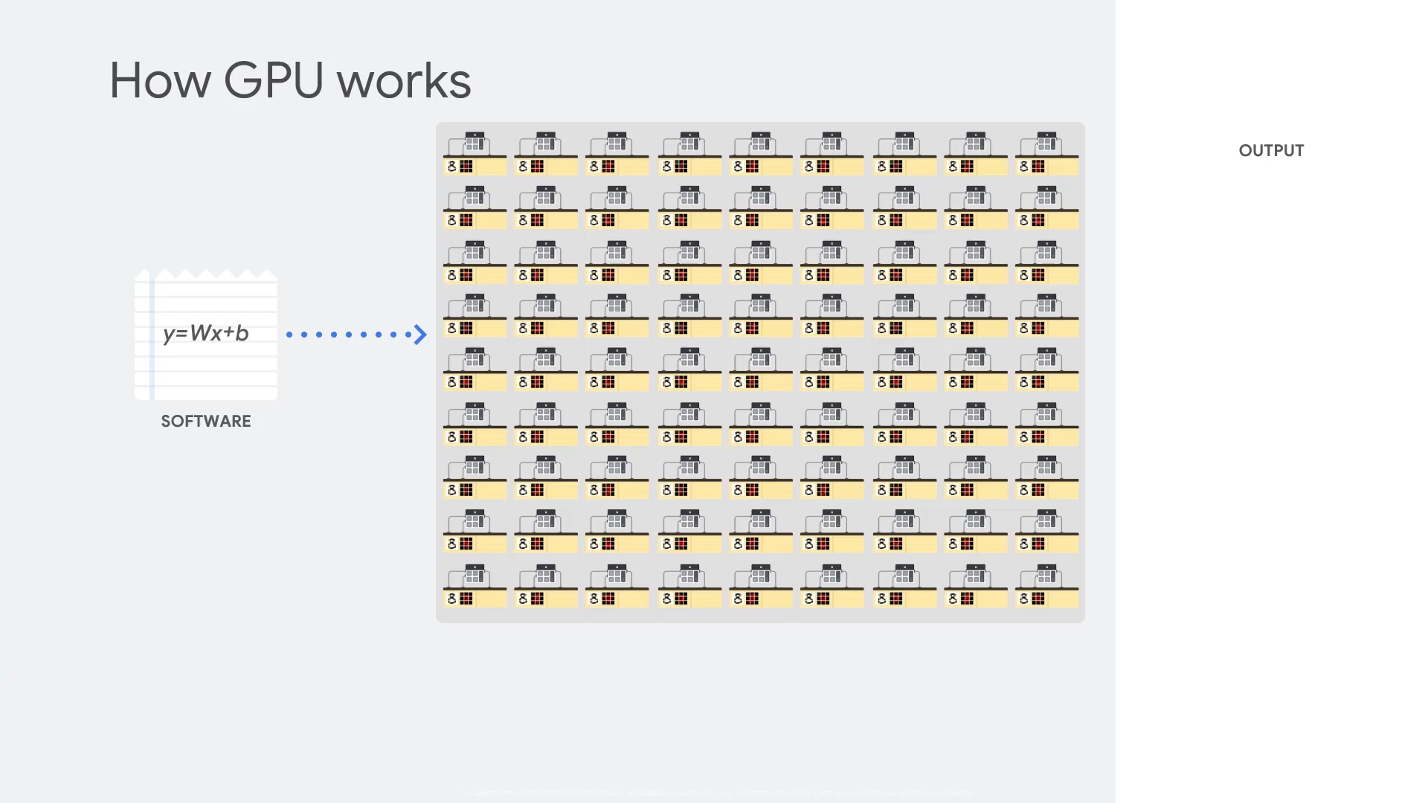

Slide 13
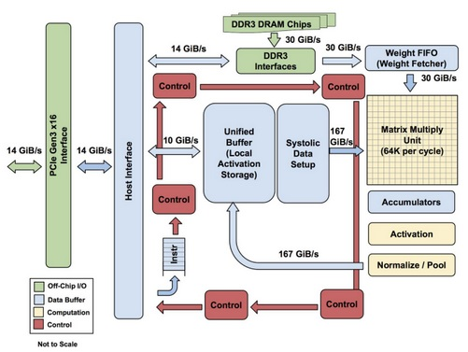
TPU
TPU is an ASIC built by Google
Can only perform matrix calculations and specialized for neural network work loads
Major reduction of von Neumann bottleneck
Thousands of multipliers and adders placed to form a large physical matrix of those operators (called as systolic array architecture)
Source: https://www.researchgate.net/profile/Stamatios-Sotiropoulos/publication/236666656/figure/fig1/AS:299544987357185@1448428498422/Typical-NVIDIA-GPU-architecture-The-GPU-is-comprised-of-a-set-of-Streaming.png

Slide 14
TPU
TPU loads data from memory and as each multiplication is executed the result is passed to next multipliers
No memory access is required at all
Less power consumption and smaller carbon footprint
Source: https://www.researchgate.net/profile/Stamatios-Sotiropoulos/publication/236666656/figure/fig1/AS:299544987357185@1448428498422/Typical-NVIDIA-GPU-architecture-The-GPU-is-comprised-of-a-set-of-Streaming.png

Slide 15
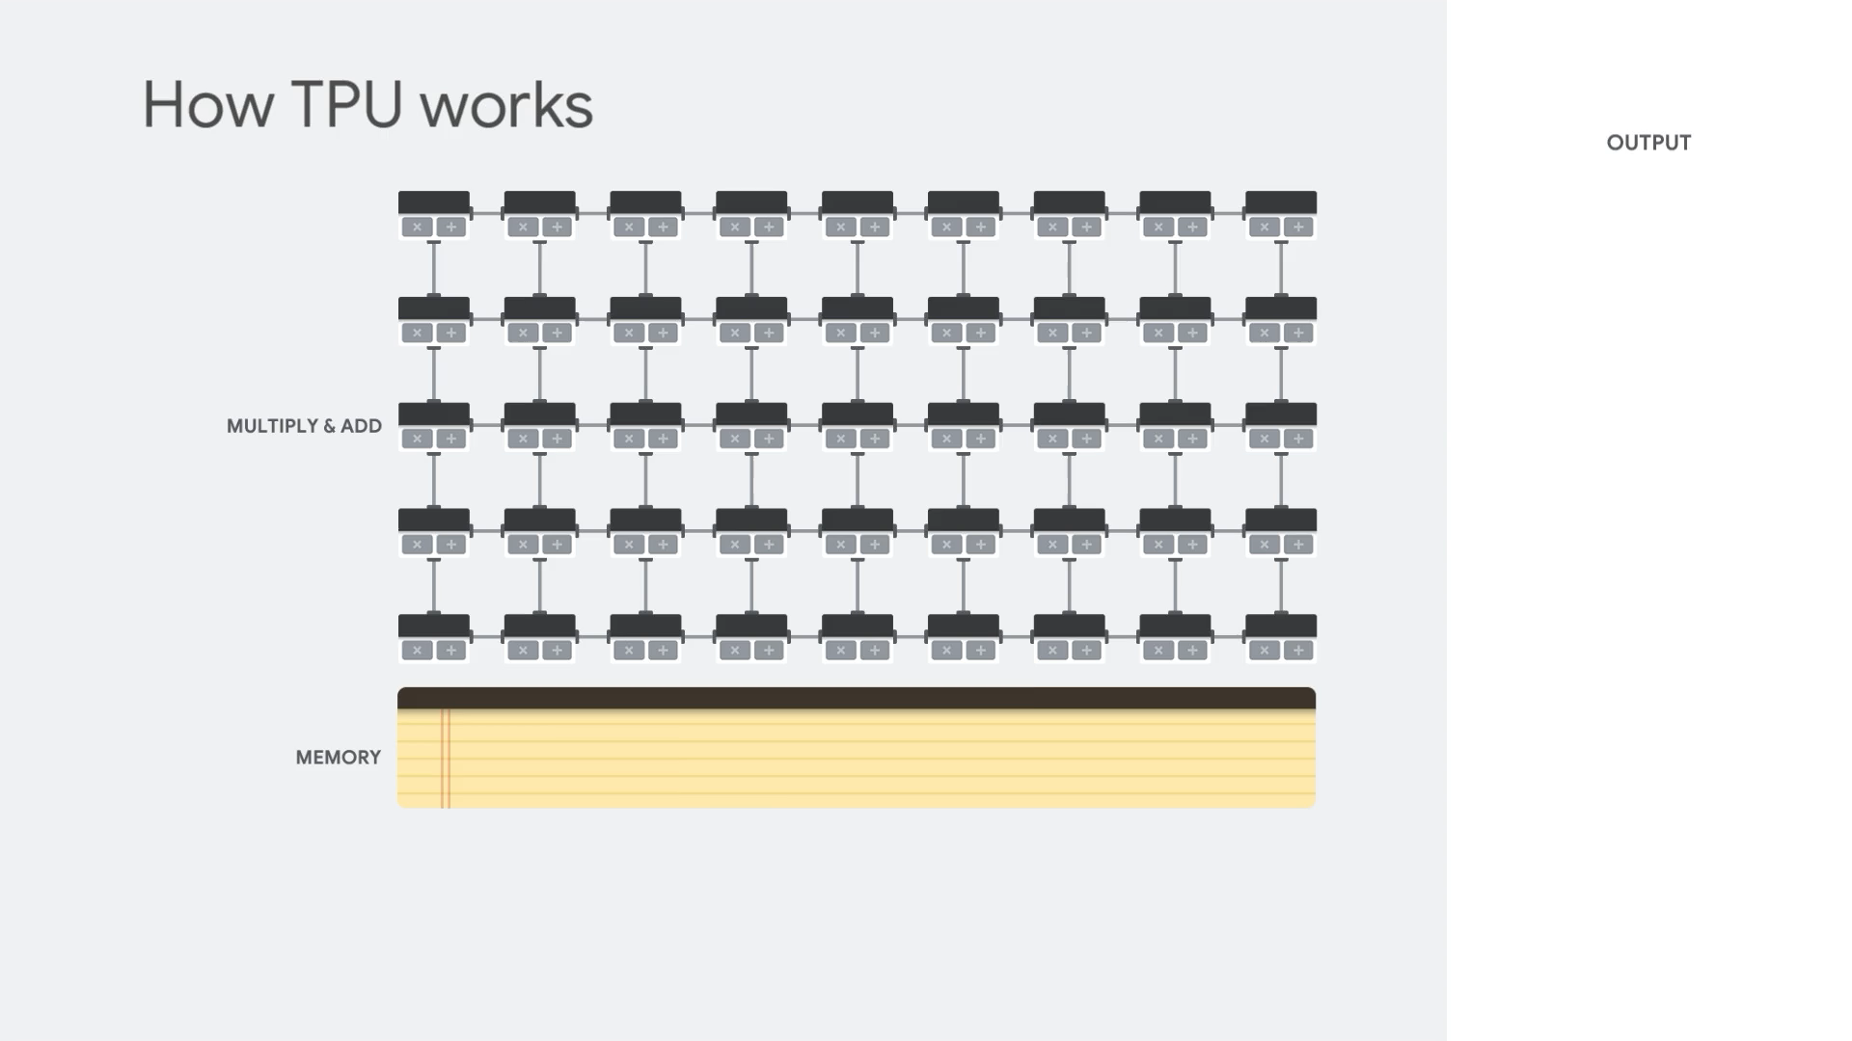

Slide 16
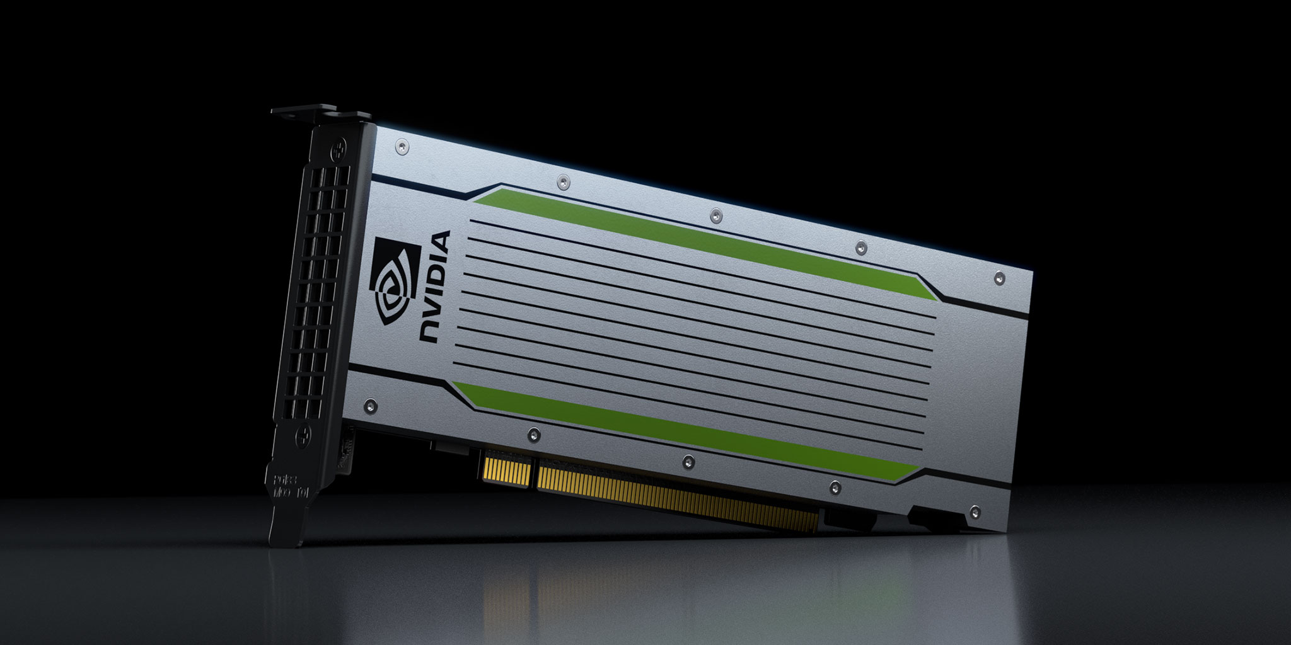
HARDWARE USED
TESLA T4
CUDA Cores | 2560
NVIDIA Turing Tensor Cores | 320
Memory | 16 GB GDDR6 with ECC
Memory Interface | 256-bit
Memory Bandwidth | 320 GB/s
Single Precision Floating Point Performance | 8.1 TFLOPS (GPU Boost Clock)
Mixed Precision (FP16 / FP32) | 65 TFLOPS
INT8-Precision | 130 TOPS
INT4-Precision | 260 TOPS
System Interface | PCI-Express 3.0 x16
Max. Power Consumption | 70 Watt
Thermal Solution | passive heatsink
Warranty | 3 Years
Source: https://www.nvidia.com/content/dam/en-zz/Solutions/Data-Center/tesla-t4/T4-LinekdIn-TW_SharedImage_2048x1024.jpg

Slide 17
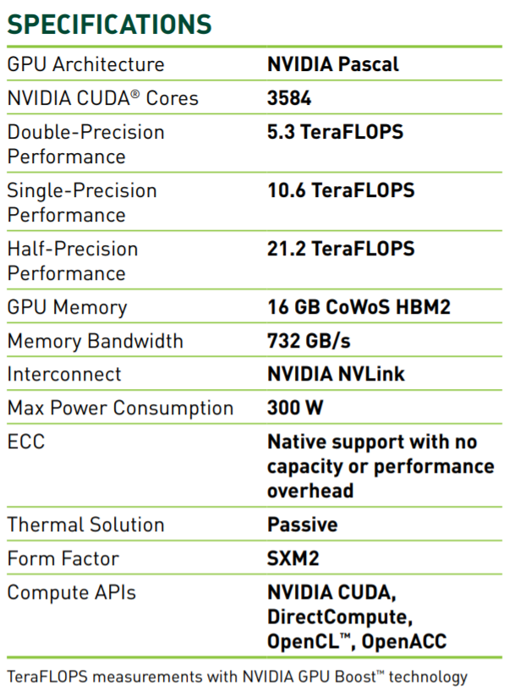
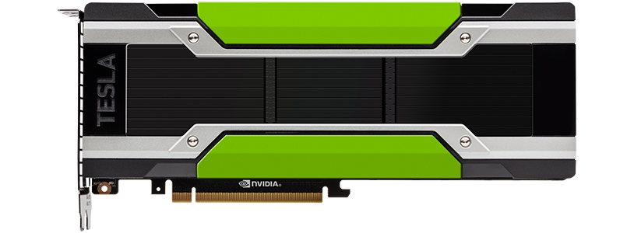
HARDWARE USED
TESLA P100
Source: https://www.nvidia.com/content/dam/en-zz/Solutions/Data-Center/tesla-p100/pdf/nvidia-tesla-p100-datasheet.pdf

Slide 18
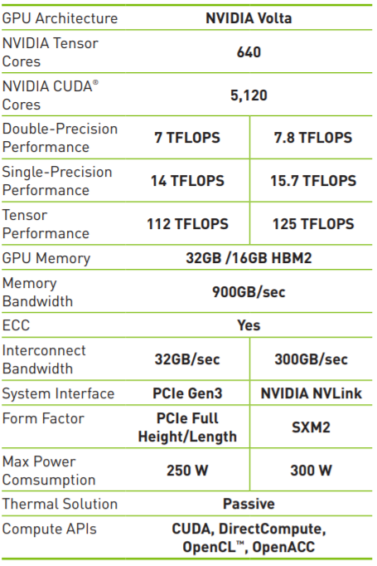
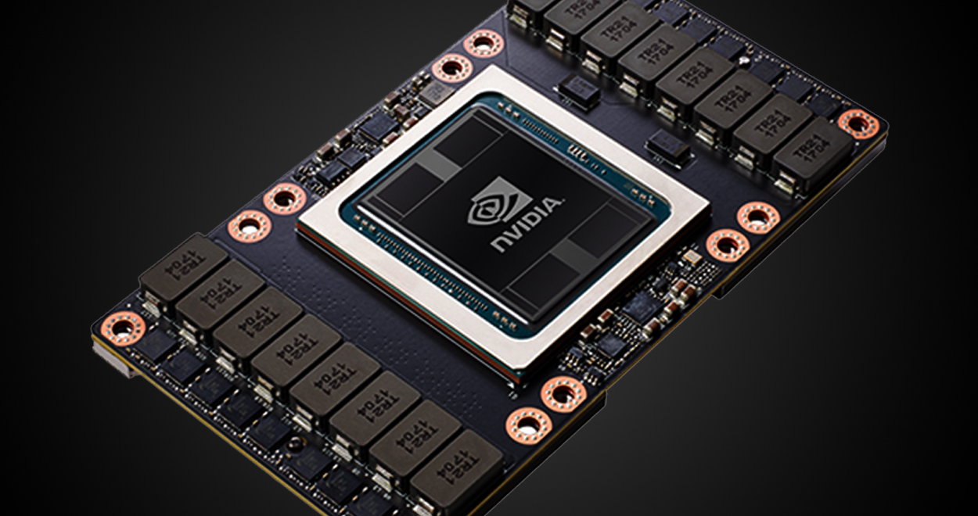
HARDWARE USED
TESLA V100
Source: https://images.nvidia.com/content/technologies/volta/pdf/tesla-volta-v100-datasheet-letter-fnl-web.pdf

Slide 19
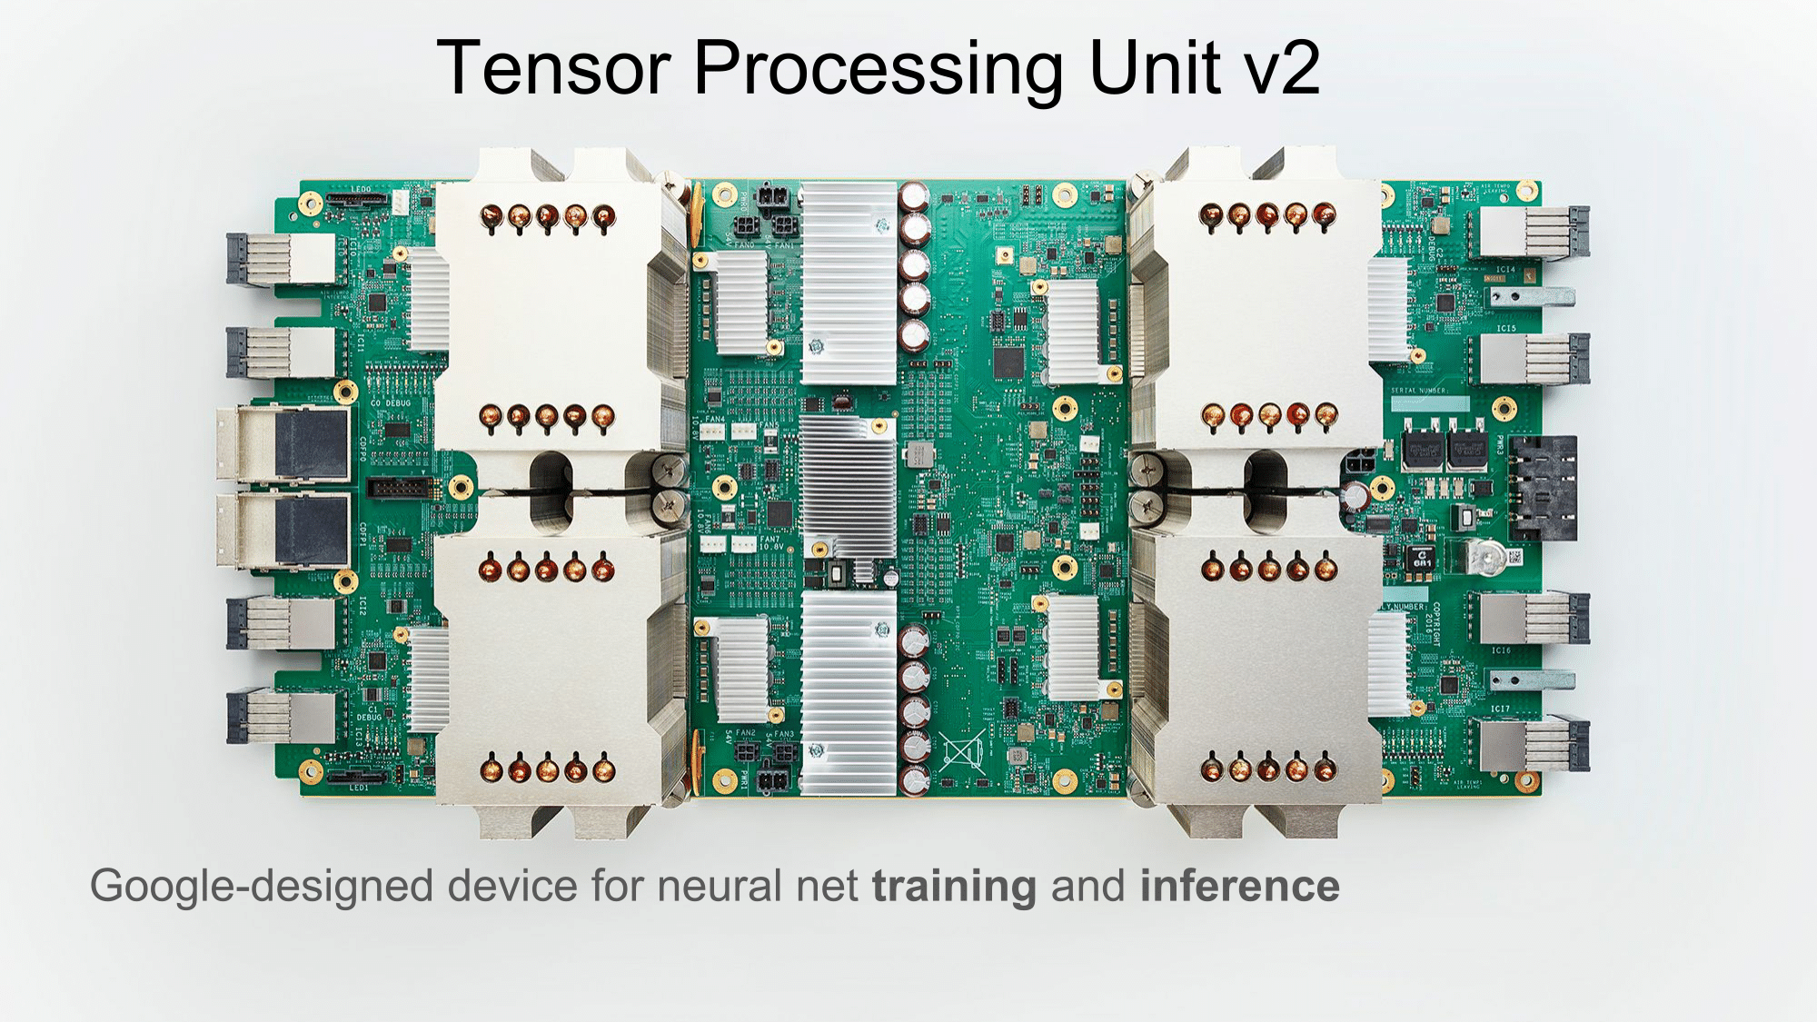
HARDWARE USED
TPU V-2
ALUs | 32,768 (16 bit floating point)
Cores | 8
Memory per core | 8 GB HBM
Total memory | 64 GB HBM
Teraflops | 180 TFLOPS
MXU per core | 1
Power consumption | 200-250W est.
Source: https://images.anandtech.com/doci/12429/dean-nips17-10.png

Slide 20
HARDWARE USED
TPU V-3
ALUs | Undisclosed
Cores | 8
Memory per core | 16 GB HBM
Total memory | 128 GB HBM
Teraflops | 420 TFLOPS
MXU per core | 2
Source: https://images.anandtech.com/doci/12429/dean-nips17-10.png

Slide 21




SOFTWARE USED

Slide 22
TRAINING SPECIFICATIONS
Data size | 12753 training images, 3712 validation images
Image size | 512 x 512
Batch Size | 64 ( 64*8 for TPUs)
Total parameters | 20,873,384
Trainable parameters | 20,873,384
Model architecture | Densenet201 with custom dense layers
Num of epochs | 30

Slide 23
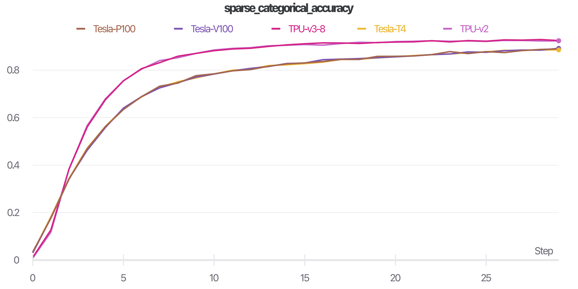
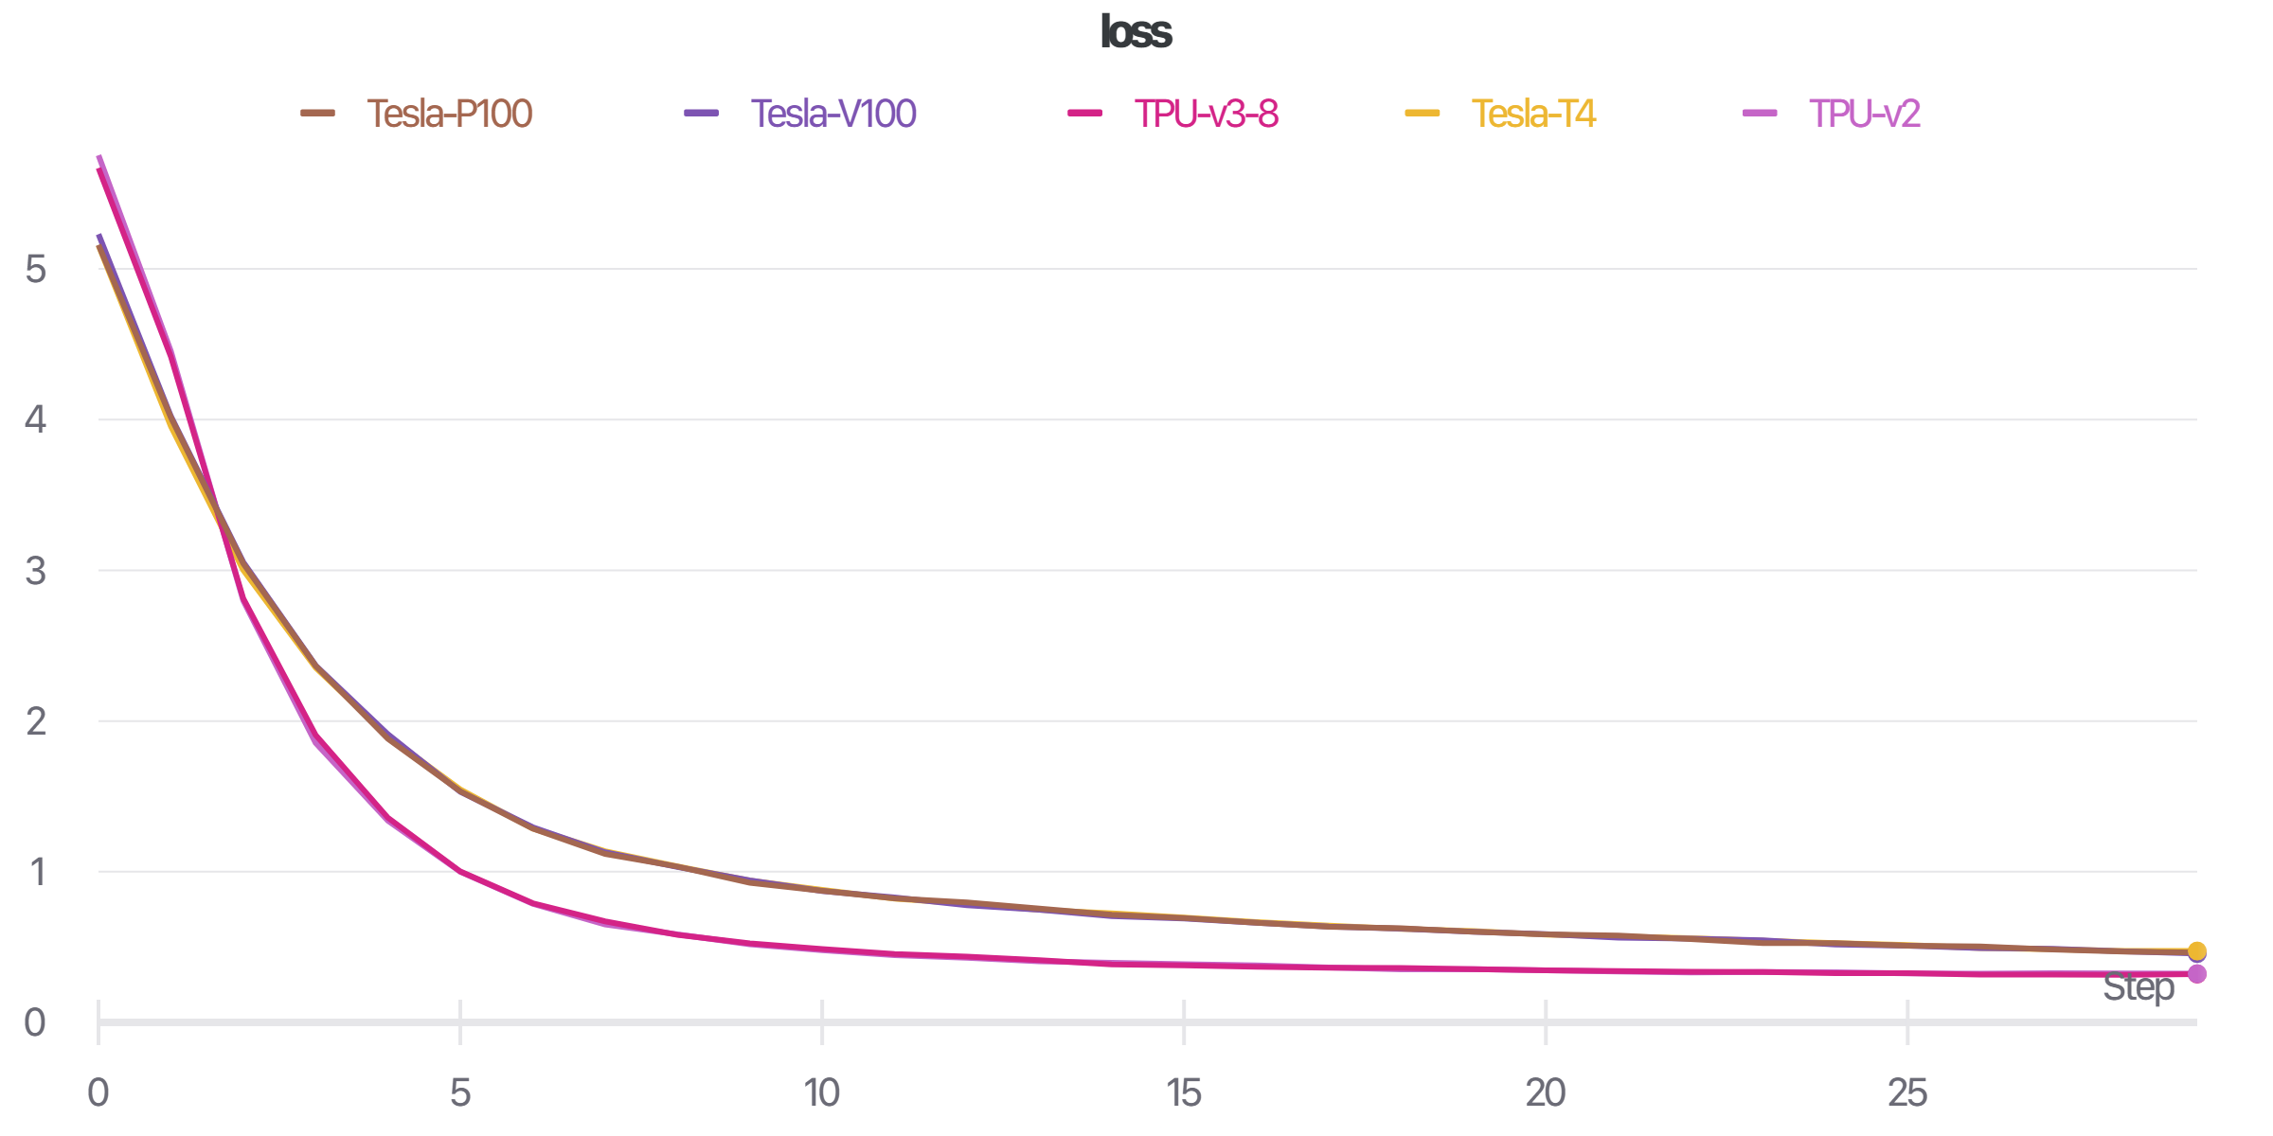
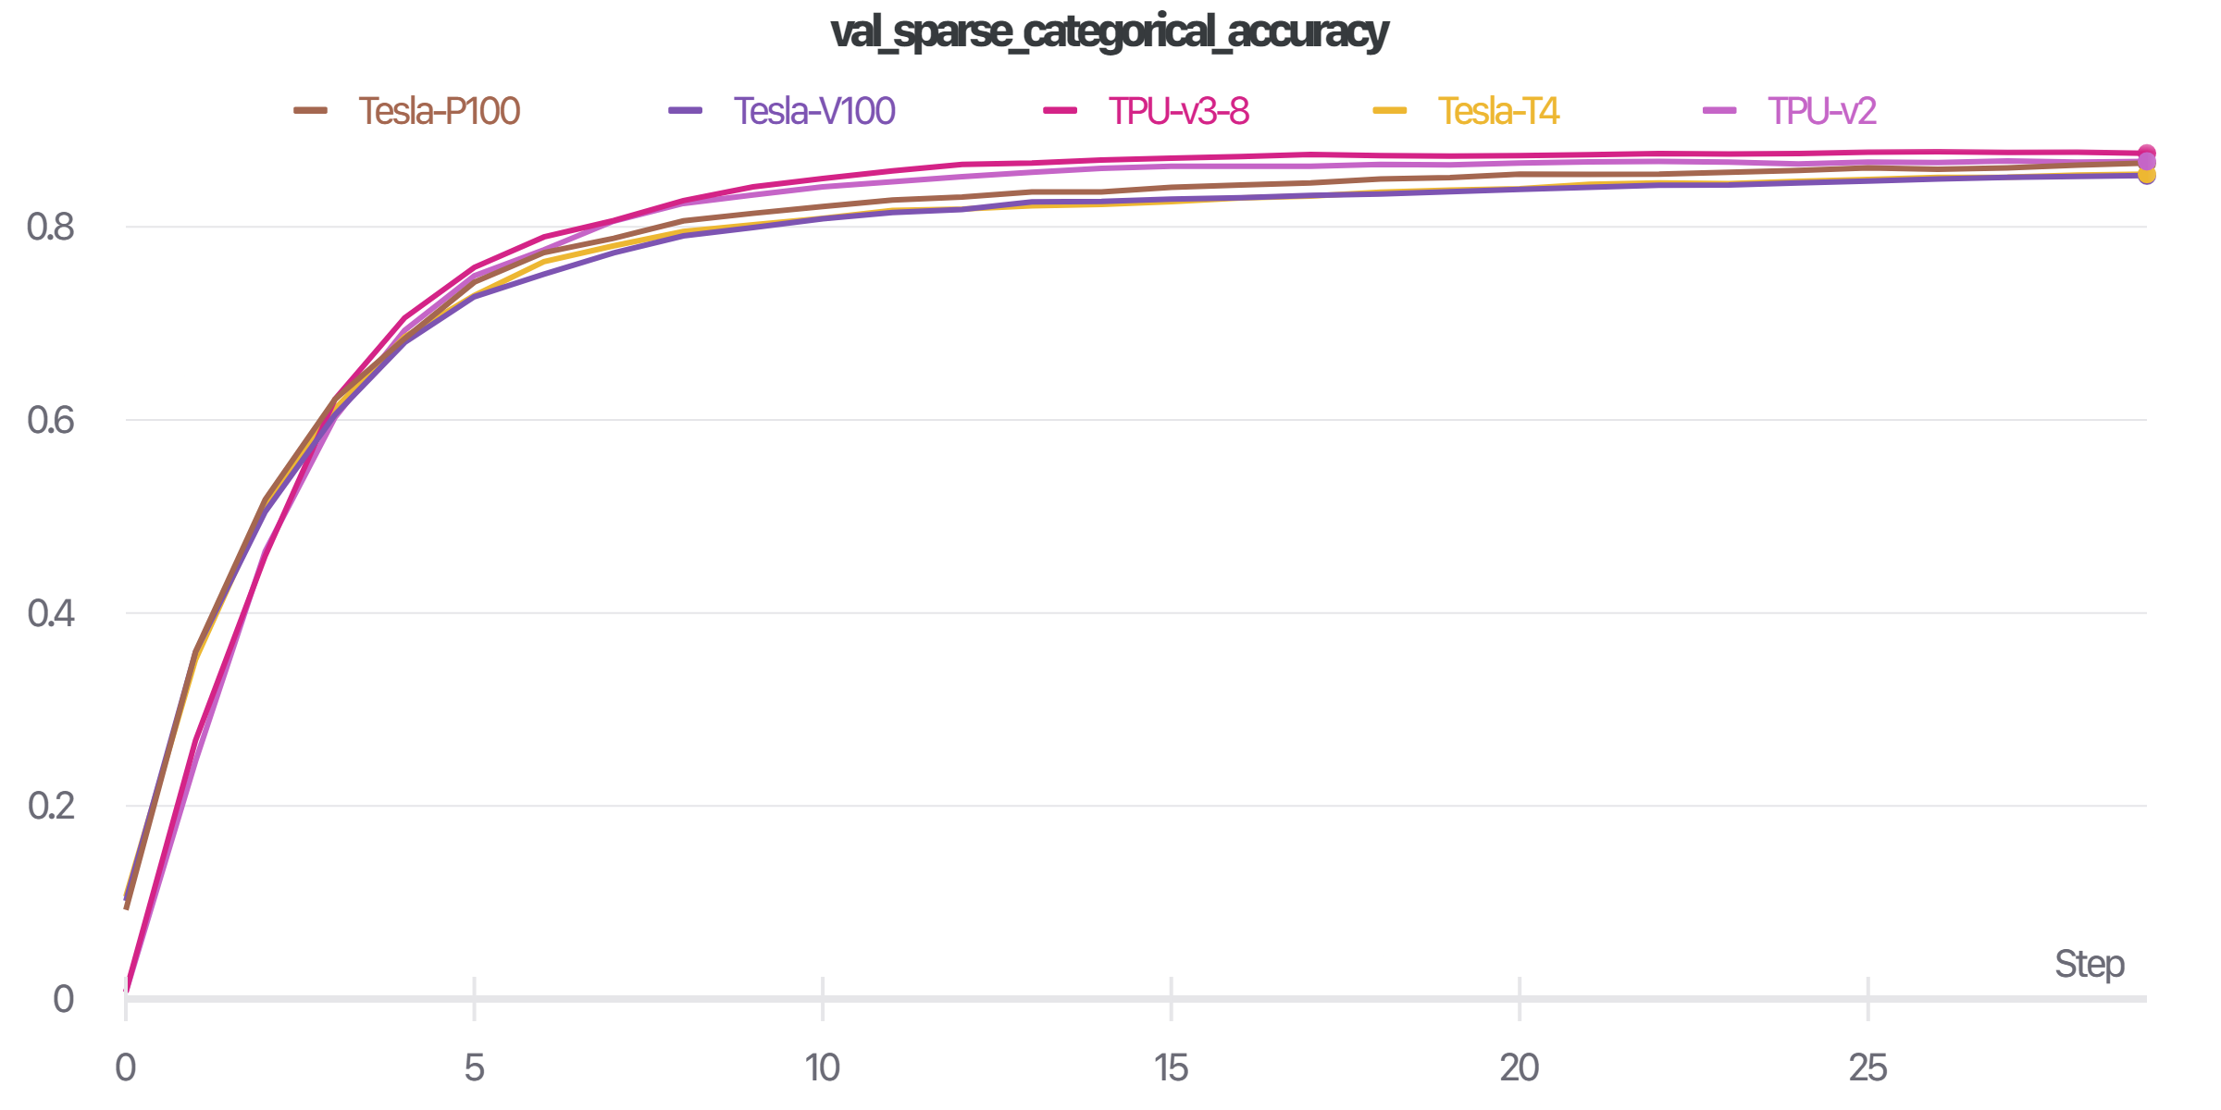
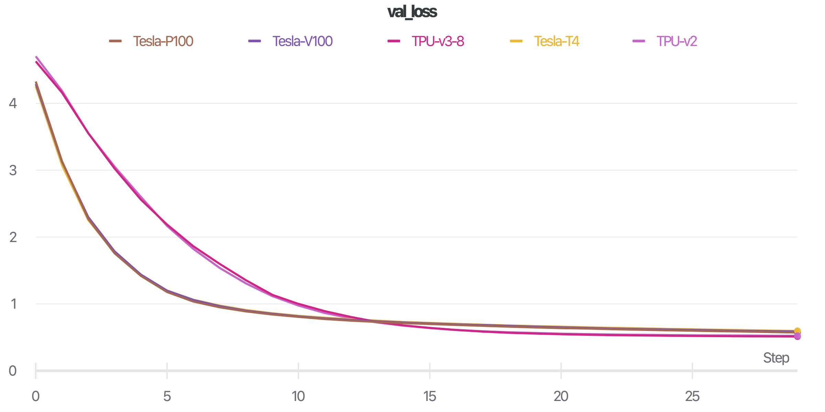
RESULTS

Slide 24
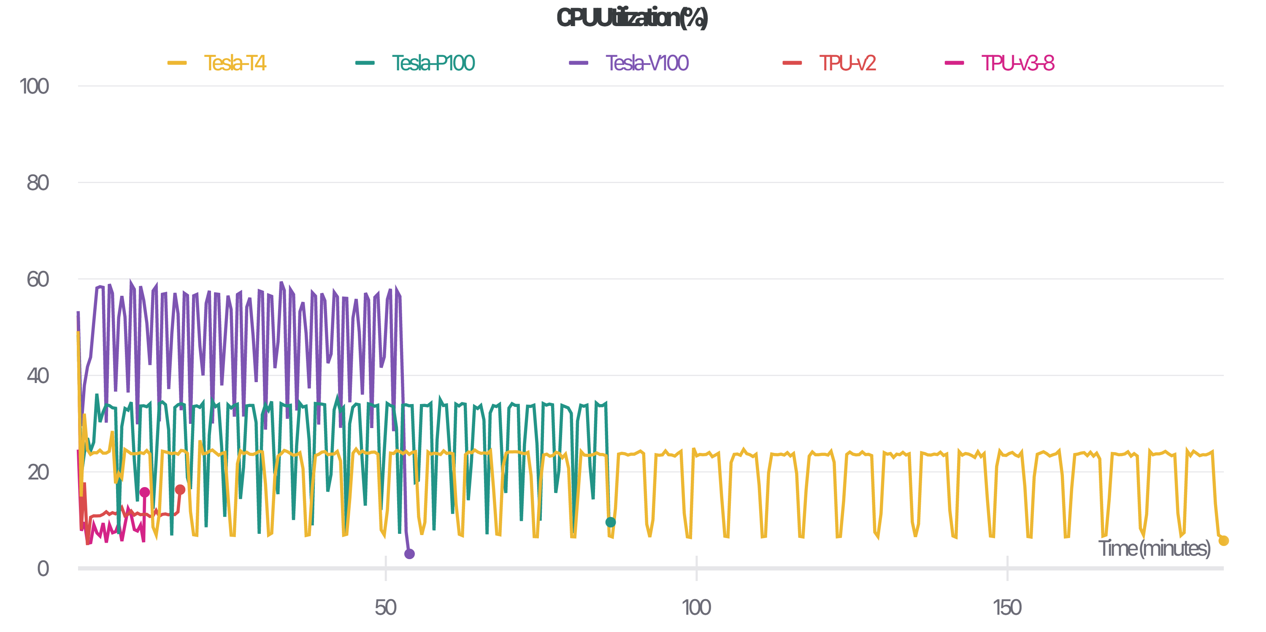
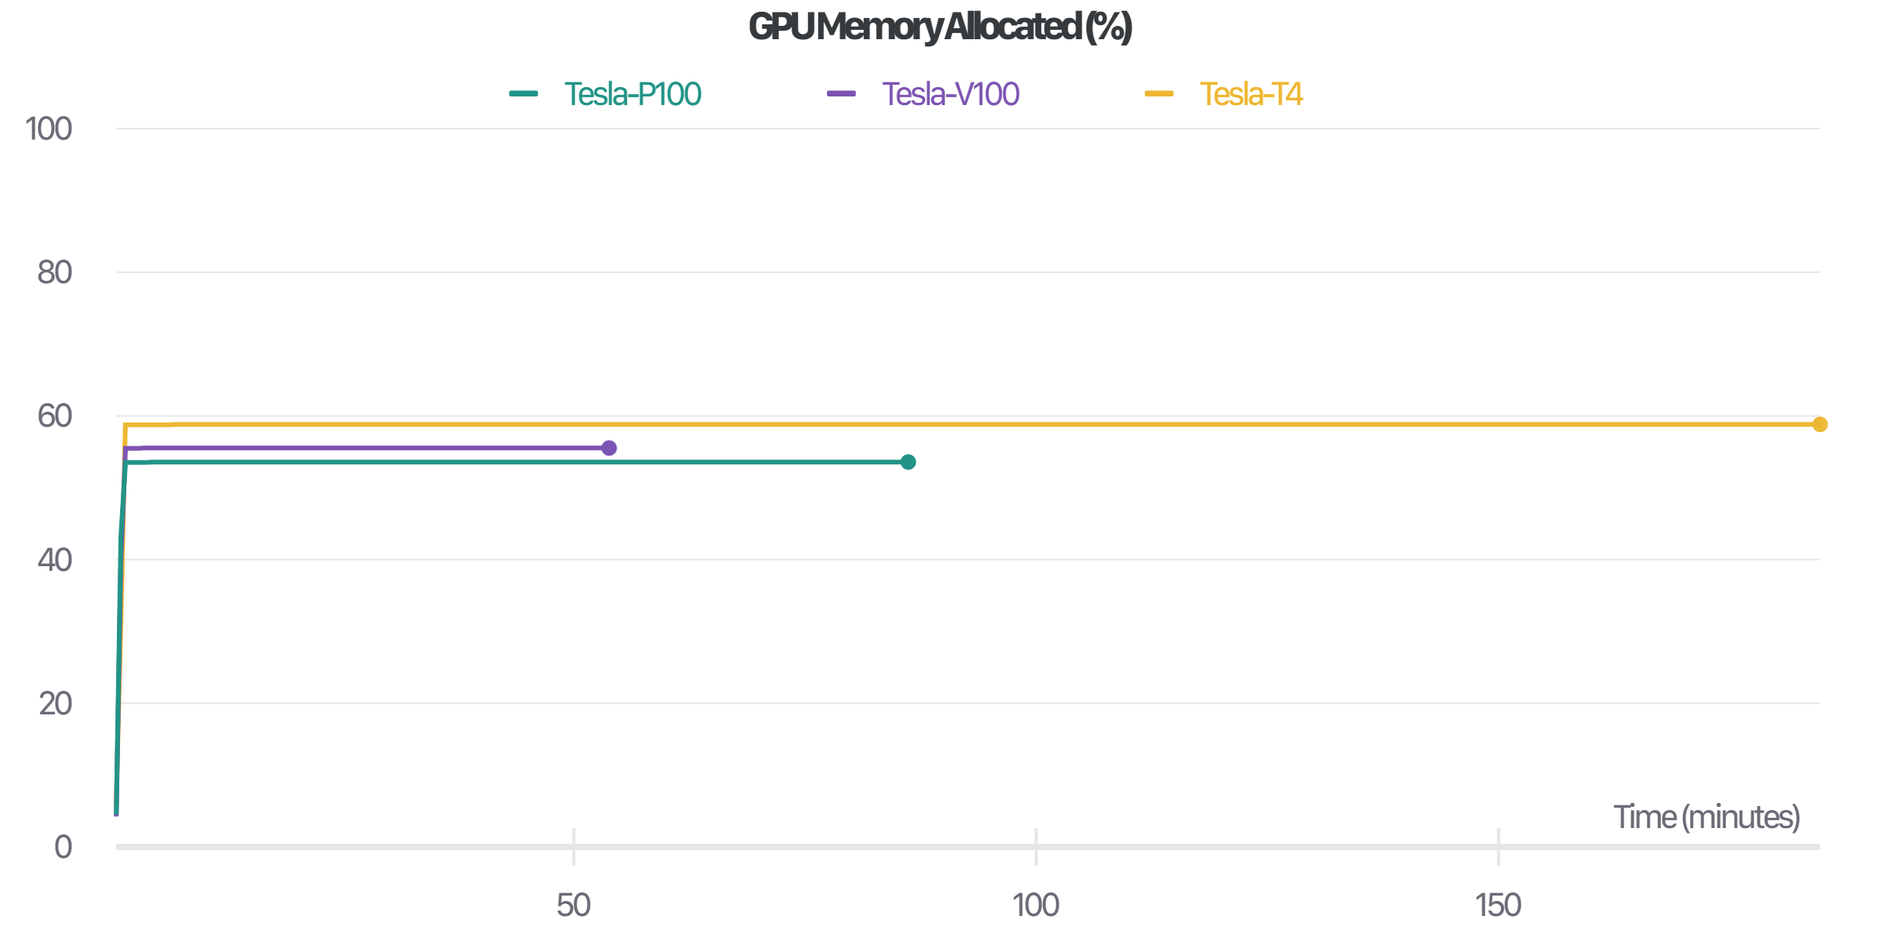
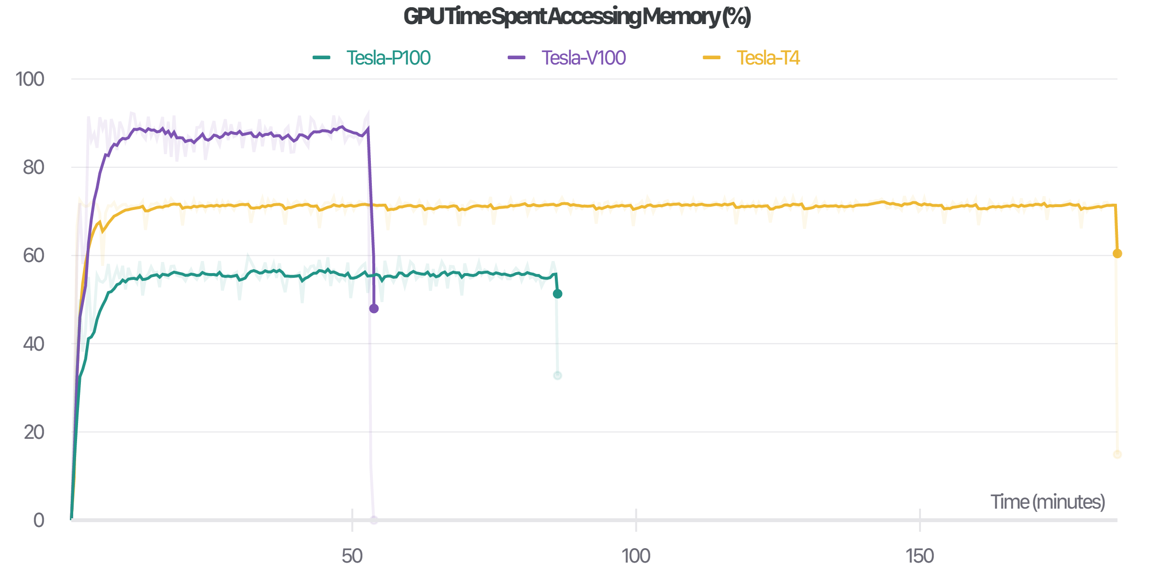
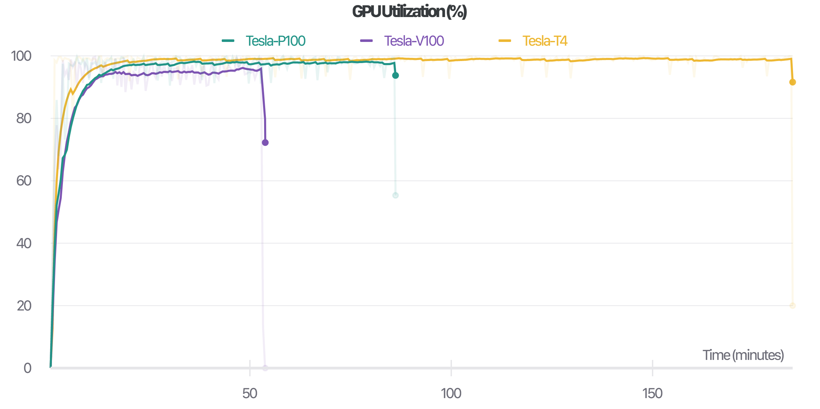
RESULTS

Slide 25
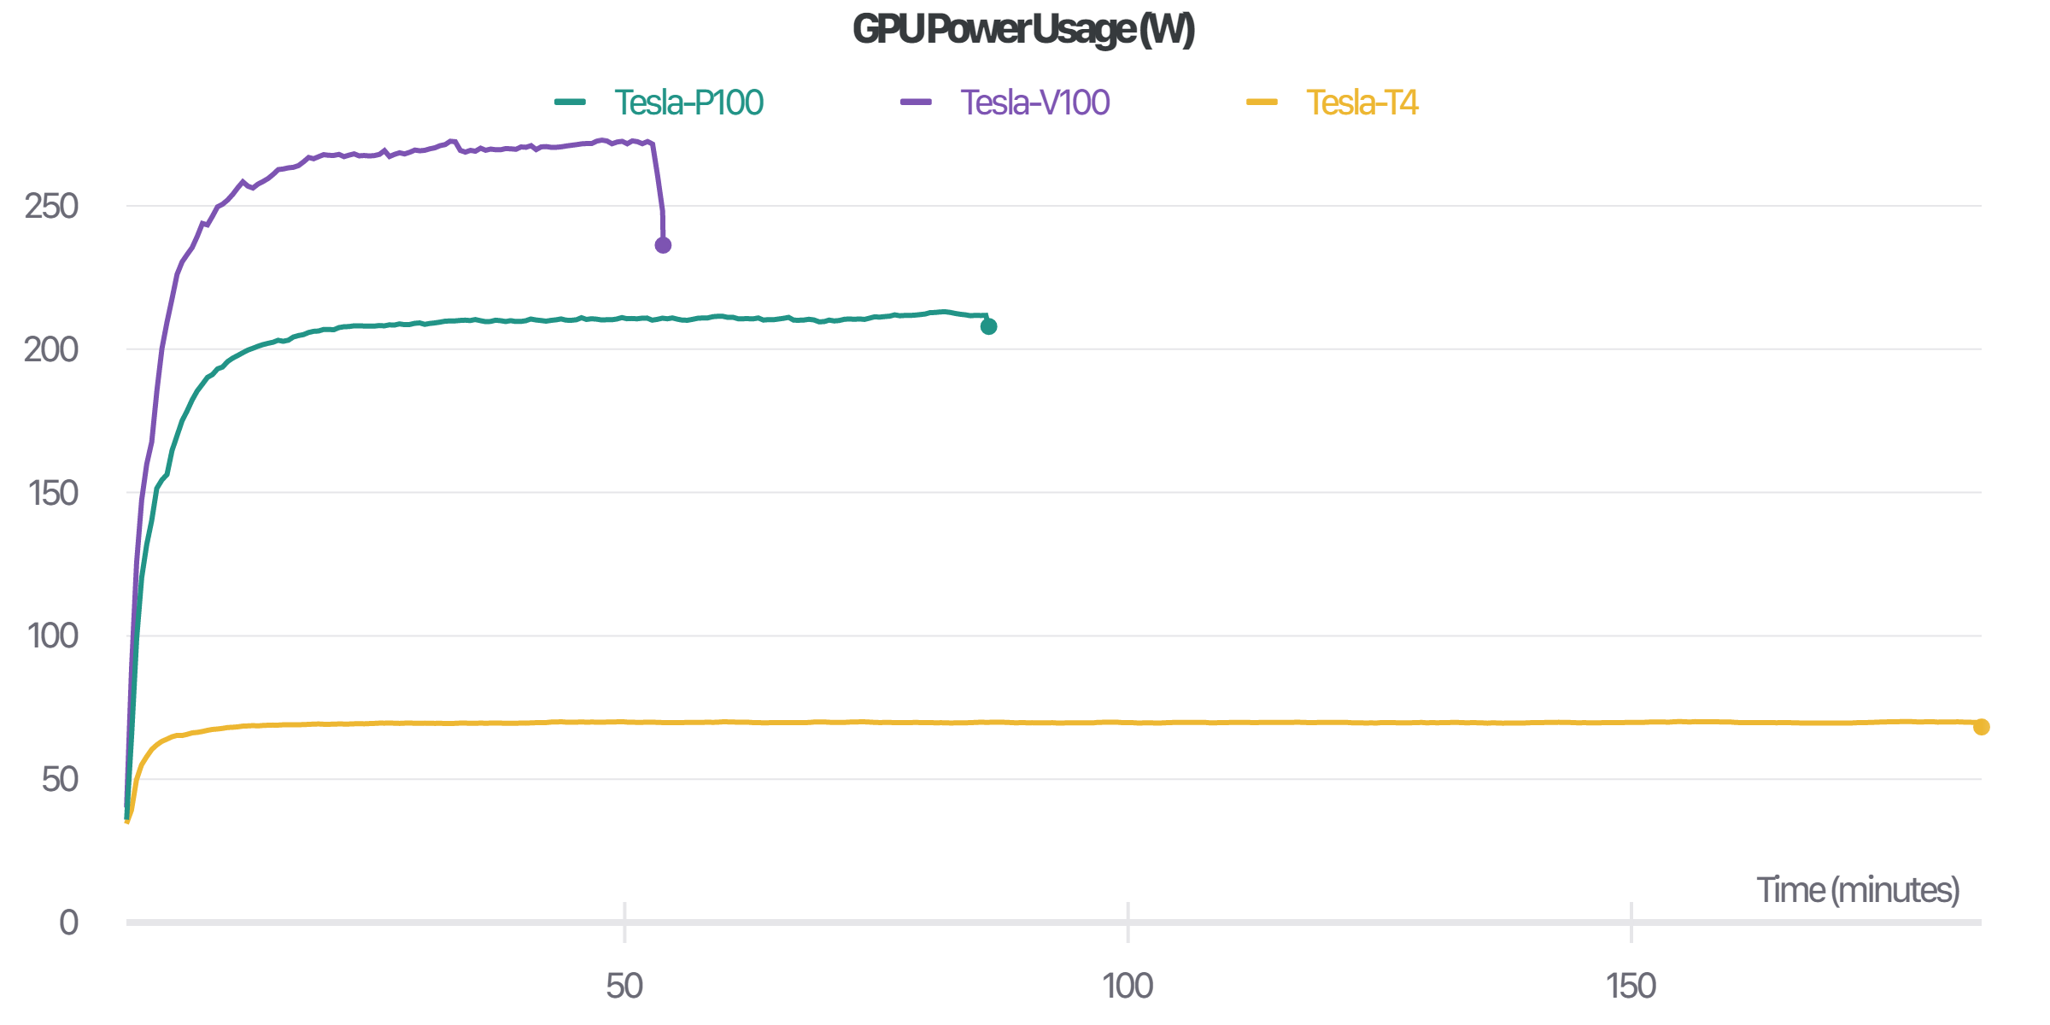
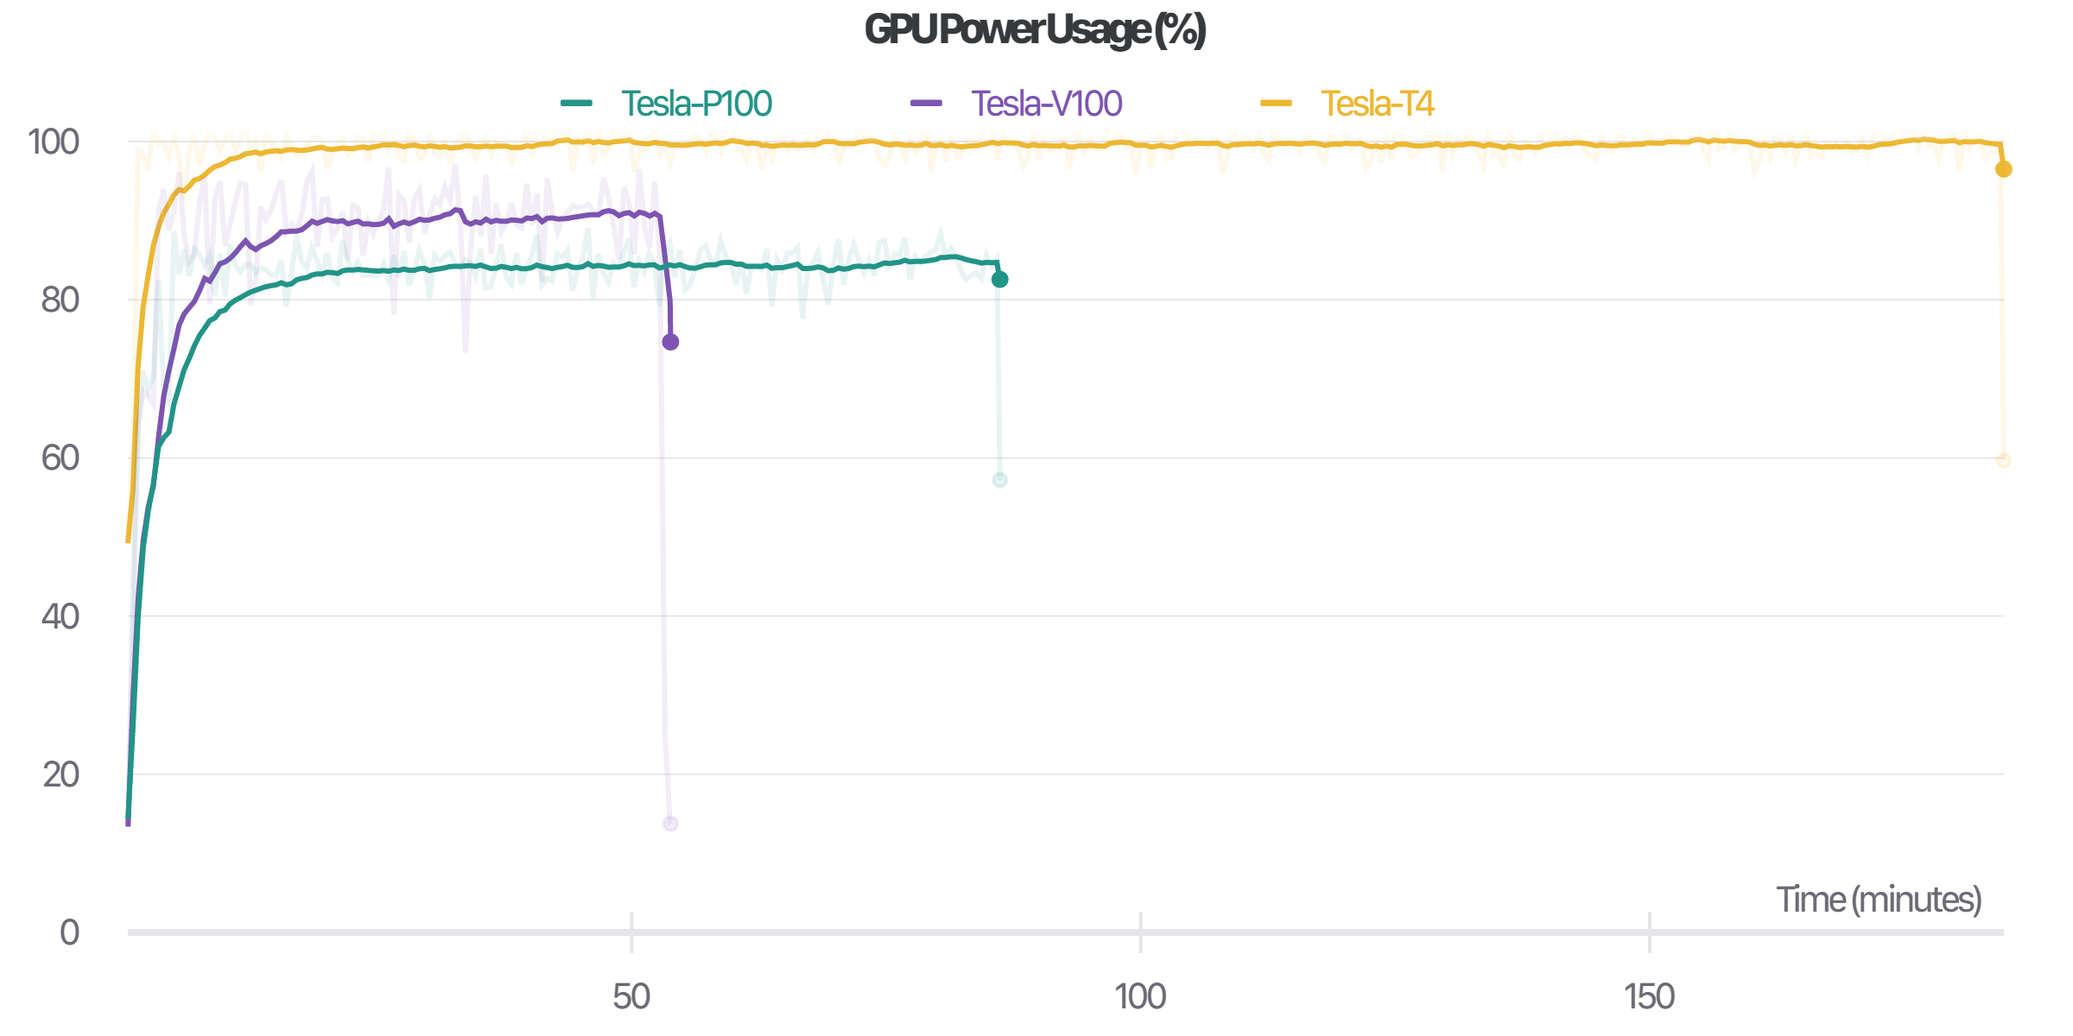
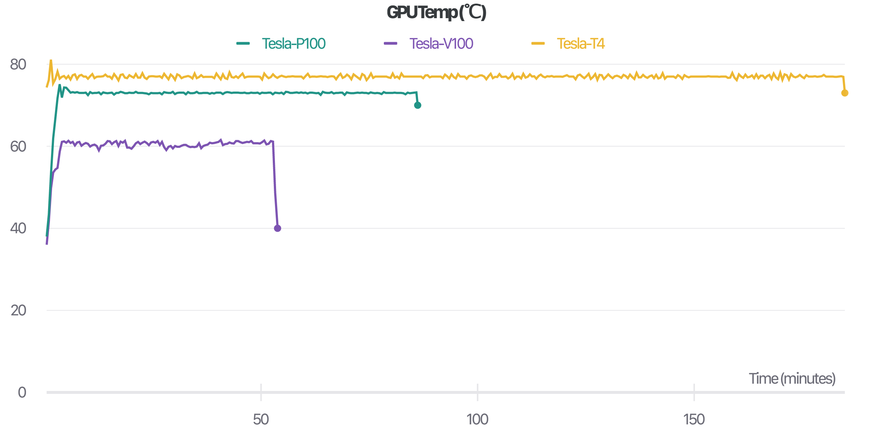
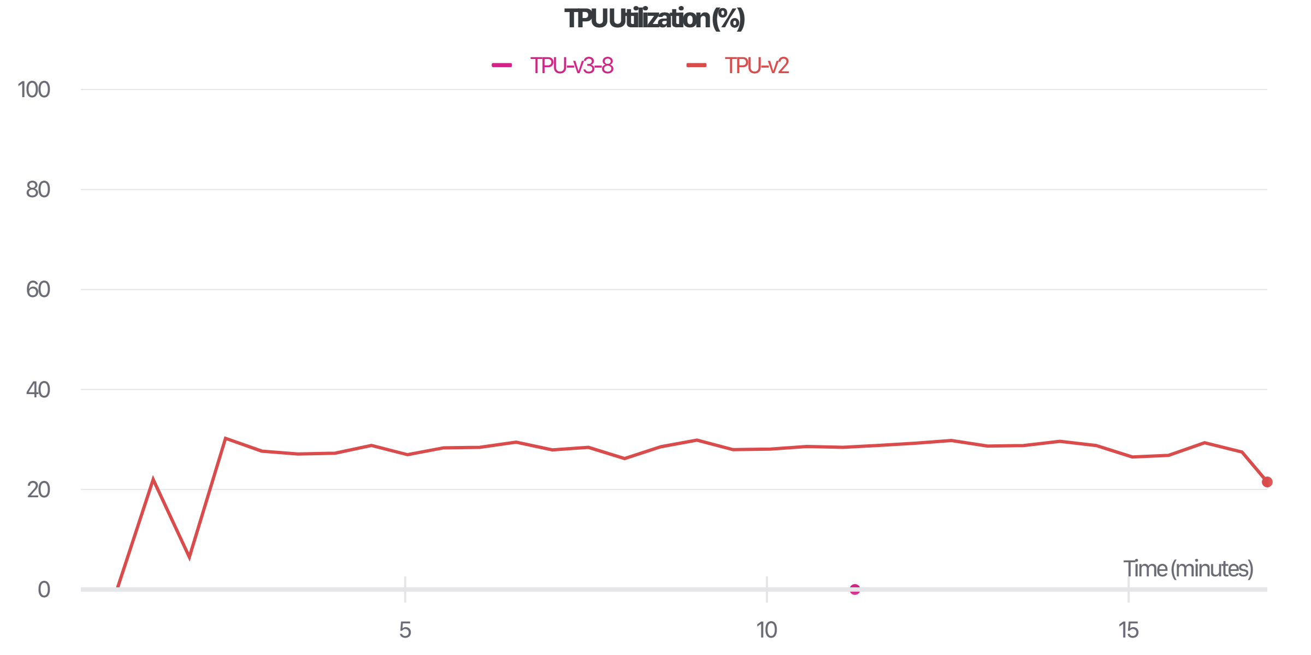
RESULTS

Slide 26
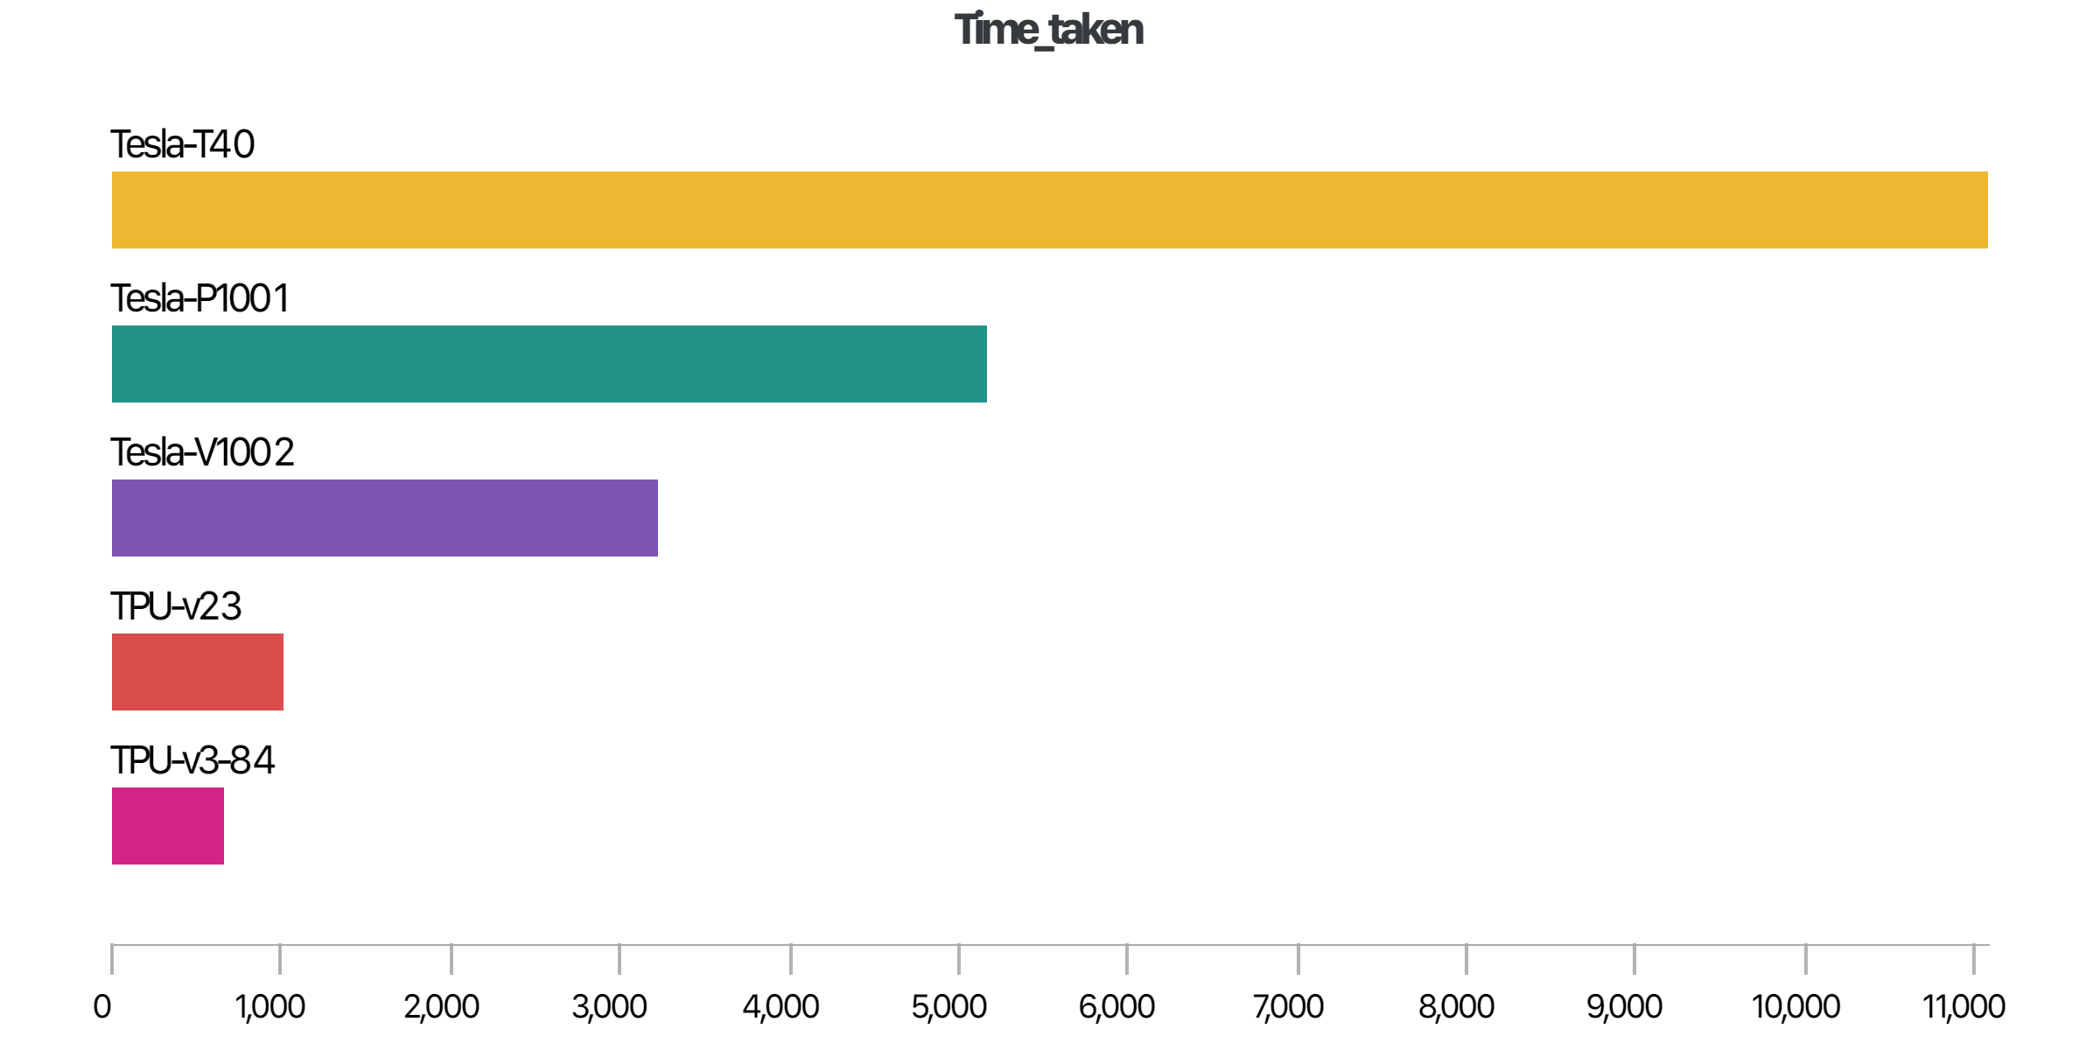
RESULTS
Tesla T4 | 183 mins
Tesla P100 | 86 mins
Tesla V100 | 54 mins
TPU v2 | 17 mins
TPU v3-8 | 11 mins
Interactive dashboard link: https://wandb.ai/gladiator/GPU-vs-TPU

Slide 27
REFERENCES
Data: https://www.kaggle.com/c/tpu-getting-started/data
TPU demo: https://tpudemo.com/
Articles: https://cloud.google.com/blog/products/ai-machine-learning/what-makes-tpus-fine-tuned-for-deep-learning
TPU architecture: https://cloud.google.com/tpu
GPU specifications: https://www.nvidia.com/en-gb/graphics-cards/

Slide 28
THANK YOU

